Slide 1
Programming paradigm

Slide 2
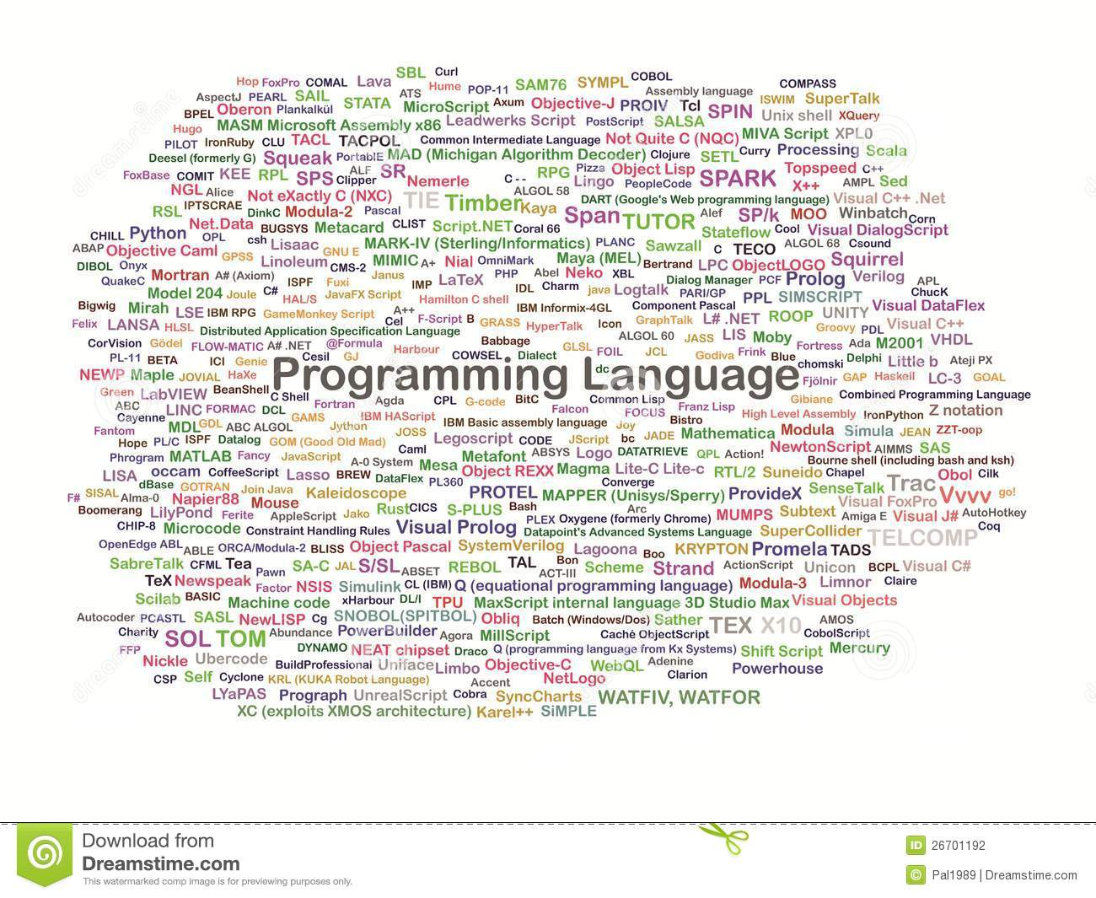

Slide 3
Programming paradigm
paradigm is a typical example or pattern of something; a model
a framework containing the basic assumptions, ways of thinking, and methodology that are commonly accepted by members of a scientific community

Slide 4
Programming paradigm
A programming paradigm is a framework that define how the user conceptualized and interpret complex problems
Programming paradigms are a way to classify programming languages according to the style of computer programming

Slide 5
Paradigms Vs Languages
Programming paradigm
An approach to programming a computer based on a mathematical theory or a coherent set of principles
Programming language
A tool for developing executable models for a class of problem domains
In general, programming paradigms influence language design

Slide 6
Programming Paradigms
Object-Oriented
Imperative
Functional
Logic
Declarative
Procedural
Symbolic

Slide 7
Imperative paradigm
Uses statements that change a program's state
Explicitly tells the computer "how": describes a sequence of steps that change the state of the computer
Imperative statements can be grouped into sections known as code blocks
In the 1950s, the idea of grouping a program's code into blocks was first implemented in the ALGOL
originally called "compound statements”
today are known as procedures

Slide 8
Imperative paradigm
First Do This
Next do that
Characterized by
Procedures
Functions
Abstract Data Types (ADTs)
Best for expressing algorithms and the most common paradigm in use today
Order of Commands is Important!!

Slide 9
Imperative paradigm
Ada (1978)
ALGOL (late 50s)
Assembly language
BASIC (1964)
Blue
C (1969)
C# (2002)
C++ (1979)
COBOL (1960)
D
FORTRAN(’54)
Go
Groovy
Java (1994)
Julia
Lua
MATLAB
Modula
MUMPS (1966)
Nim
Oberon
OCaml
Pascal (70s)
Perl (1987)
PHP (1994)
PROSE
Python (1990)
Ruby (1995)
Rust

Slide 10
Functional paradigm
A style of building the structure and elements of computer programs—that treats computation as the evaluation of mathematical functions and avoids changing-state and mutable data
It is a declarative programming paradigm, which means programming is done with expressions or declarations instead of statements

Slide 11
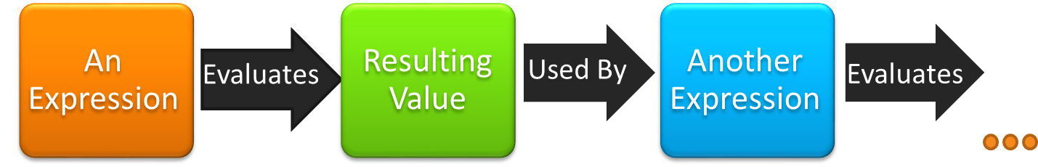
Functional paradigm
View everything as “functions”
Characterized by
Single Assignment
Referentially Transparent
Compositionality
Higher Order Function
Best for abstracting and reducing complexity in programming task with no side effects
Notes:
Given an expression, it is evaluates to a resulting value. This value can then be use as an input for another expression, which is then evaluated and produce another result. This process can be repeated recursively until it no further actions.
For functional paradigm, we view everything as “functions”. Unlike OO, the state between successive method calls are not stored and the functions cannot modify the variables. Thus data and functions are completely separated, opposing to the encapsulation characteristic of OO.
It is characterized by single assignment for variables, referentially transparent, compositionality and higher order function. Functional Paradigm is best for abstracting and reducing complexity of tasks with no side effects. The side effect is defined as a non-local change to something other than its inputs and declared output. And thus, it is less complicated than imperative (as in use lesser instructions) and can improve the overall productivity.
- Referentially transparent means a function invoked can be freely replaced with it’s return value without changing program semantics
Compositionality -> meaning of a complex expression is determined by the meanings of its constituent expressions and the rules used to combine them

Slide 12
Functional paradigm
Emphasized in academia rather than in commercial software development
Prominent programming languages which support functional programming such as Common Lisp, Scheme, Clojure, Wolfram Language (also known as Mathematica), Racket, etc. have been used in industrial and commercial applications
Functional programming is also supported in some domain-specific programming languages like R (statistics), J, K and Q from Kx Systems (financial analysis), XQuery/XSLT (XML), and Opal

Slide 13
Declarative paradigm
A style of building the structure and elements of computer programs—that expresses the logic of a computation without describing its control flow
Describing what the program must accomplish in terms of the problem domain
This is in contrast with imperative programming, which implements algorithms in explicit steps
Declarative programming often considers programs as theories of a formal logic, and computations as deductions in that logic space

Slide 14
Declarative paradigm
Analytica
Ant
DASL
Lustre
Mercury
MetaPost
Modelica
Prolog
Oz
RDQL
SequenceL
SPARQL
SQL
Wolfram Language
xBase
XSLTransformations

Slide 15
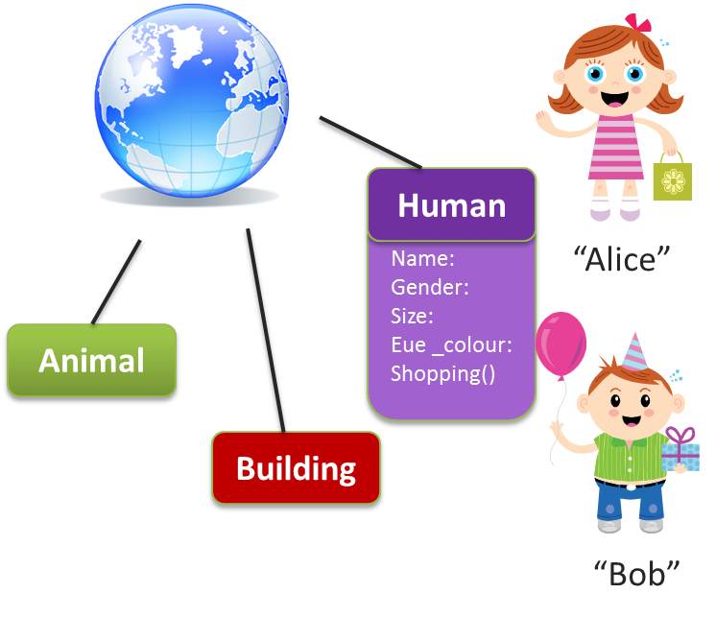
Object-Oriented paradigm
View everything as an “object”
Key characteristic of OO
Data Abstraction
Encapsulation
Polymorphism
Inheritance
Best for problems with a large number of related data abstractions organized in a hierarchy

Slide 16
Object-Oriented paradigm
Many of the most widely used programming languages are multi-paradigm programming languages that support object-oriented programming to a greater or lesser degree, typically in combination with imperative, procedural programming.
Significant object-oriented languages include Java, C++, C#, Python, PHP, Ruby, Perl, Delphi, Objective-C, Swift, Scala, Common Lisp, and Smalltalk

Slide 17
Procedural paradigm
Procedural programming is a type of imperative programming in which the program is built from one or more procedures (also termed subroutines or functions)
Uses statements that change a program's state
Explicitly tells the computer "how": describes a sequence of steps that change the state of the computer

Slide 18
Procedural paradigm
Procedural | Object-oriented
procedure | method
record | object
module | class
procedure call | message
Fortran
ALGOL
COBOL
BASIC
Pascal and C (1970s)
Ada (1980)
Go (2009)

Slide 19
Logic paradigm
A type of programming paradigm which is largely based on formal logic
Any program written in a logic programming language is a set of sentences in logical form, expressing facts and rules about some problem domain
Major logic programming language families include Prolog, Answer set programming (ASP) and Datalog

Slide 20
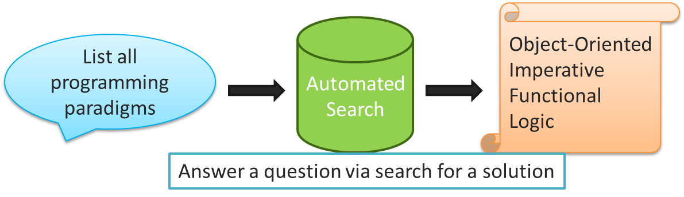
Logic paradigm
View everything as “Predicate Calculus”
Characterized by
Axioms
Facts
Inference rules
Queries
Best for solving problems in artificial intelligence such as medical diagnosis, fault finding in equipment and robot control
Notes:
Logic paradigm which is quite different from other paradigms as we just have to tell the computer what is needed but do not have to provide the details on how to do it. For example, we can indicate the query to list all programming paradigms, the computer will search for the result automatically, then outputs the lists.
Logic paradigm view everything as “Predicate Calculus” which is a branch of mathematics that deals with logic. It is characterized by axioms, facts, inference rules and queries. Hence, it is best for solving problems in artificial intelligence, where the agents requires facts and do reasoning on their queries to conclude which actions to take. Examples include medical diagnosis, fault finding in equipment and robot control.

Slide 21
Programming paradigm
Each paradigm has its place
Learning different paradigms allow us to
Identify suitable paradigms for a given complex problem
Decide the most suitable language to implement
Reason for focusing on paradigms
Increasing number of programming languages implementing similar paradigms exists
27 paradigms in total but some are in similar concept
Studying the 7 distinct basic paradigms allow us to easily pick up any programming languages on our own

Slide 22
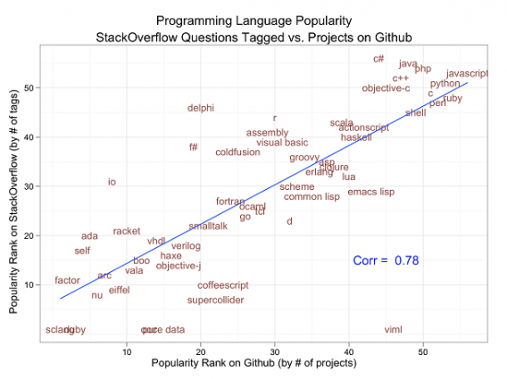

Slide 23
How many programming languages
https://www.quora.com/How-many-programming-languages-are-there-in-the-world

